Slide 1

SDET Course
Design Patterns - Visitor

Slide 2
3 Types of Design Patterns
Creational
Singleton
Builder
Prototype
Factory Method
Abstract Factory
Structural
Adapter
Composite
Proxy
Flyweight
Bridge
Facade
Decorator
Behavioral
Strategy
Observer
Command
Memento
State
Template Method
Mediator
Chain of Responsibility
Interpreter
Visitor
Iterator

Slide 3
Agenda
Description
Diagram
Code sample (Java)
Use cases

Slide 4
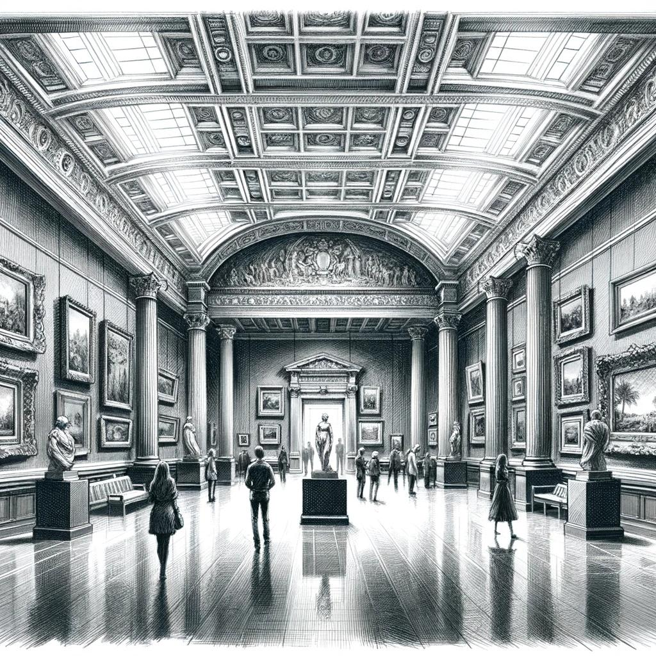
Description
Introduction - The Visitor

Slide 5
Description
The Visitor design pattern is a behavioral pattern in software engineering that facilitates adding new operations or functionalities to a collection of objects without altering their structure. It separates the algorithm from the object structure upon which it operates. The pattern involves defining a visitor interface with methods corresponding to each class in the object structure. Each class then accepts visitors, allowing them to perform operations specific to their type. This pattern is particularly useful when the object structure is complex and changes infrequently, but new operations need to be added frequently. It promotes extensibility and maintainability by encapsulating operations in separate visitor classes, enhancing the flexibility of the system.

Slide 6
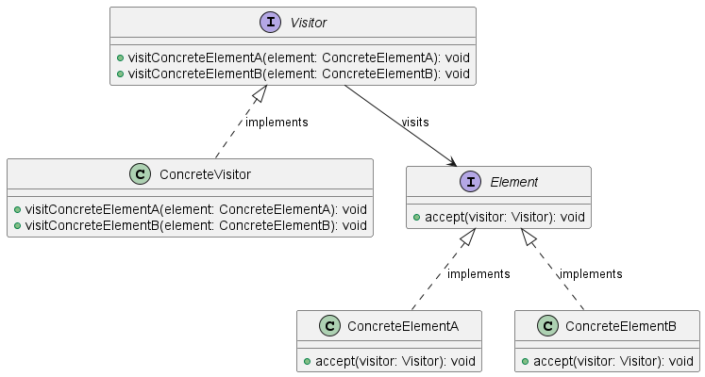
Class Diagram

Slide 7
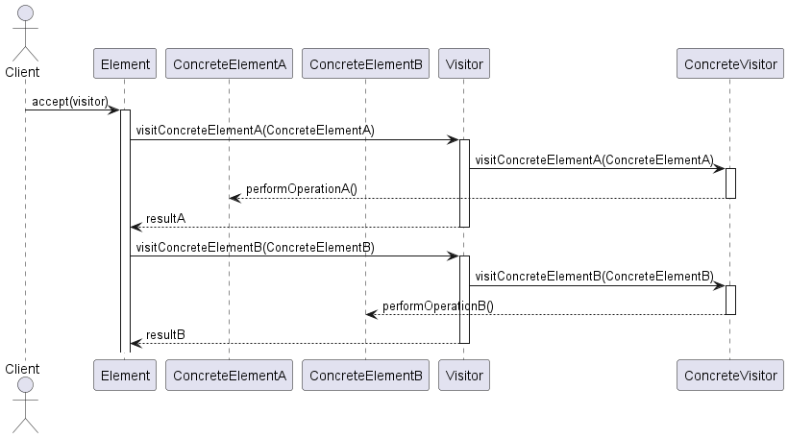
Sequence Diagram

Slide 8
Code Sample

Slide 9
Use cases
General
Document Processing (XML, JSON): Validation, Transformation, Extraction
Data Structure Operations: Trees / Graphs data design, perform search, manipulation etc.
Database Query Processing: Optimization / Execution strategy
In Test Automation
Optimize SQL
Build Smart Page Objects

Slide 10
Happy Coding

